Slide 1

DRUG PERSISTENCY – EXPLORATORY DATA ANALYSIS
ABC PHARMA PROJECT
Group Name : SoloVision Analytics
Prepared By : Ankita Roy
Virtual Internship Program
Date : 16/06/25

Slide 2

PROBLEM DESCRIPTION
Drug persistency is a key metric in determining the long-term success of a treatment regimen. It reflects whether patients continue using a prescribed therapy as advised. Pharmaceutical companies like ABC Pharma often struggle to identify the factors that cause patients to discontinue treatment.
To address this, ABC Pharma has sought the help of data science to automate the detection of persistency patterns among patients using their drug. The aim is to develop a classification model that predicts whether a patient is likely to persist with the treatment based on demographic, clinical, and behavioural data.
The binary target variable for this task is Persistency_Flag, where the goal is to classify patients as either persistent or non-persistent.

Slide 3
PROJECT OBJECTIVE
Understand patient persistency patterns
Identify key factors impacting persistency
Build classification models to predict persistency
Recommend actionable insights for healthcare teams

Slide 4
DATASET OVERVIEW
3424 number of rows with 68 features
Features cover Demographics, Clinical Factors, Physician Details, Treatment Usage, Adherence etc.
Target variable : Persistency Flag (Persistent vs Non-Persistent)
No missing values
No duplicates as well
Each record = Unique patient ID

Slide 5
VARIABLES SUMMARY
Data Types & Variables:
Numerical Variables: Dexa frequency, Count of risks
Categorical Variables: Persistency Flag, Gender, Race, Ethnicity, Region, Age bucket, Ntm speciality, Ntm speciality flag, Ntm speciality bucket, Gluco record prior Ntm, Gluco record during Rx, Dexa during Rx, Fragility fracture prior Ntm, Fragility fracture during Rx, Risk segment prior Ntm, Risk segment during Rx, Tscore bucket prior Ntm, Tscore bucket during Rx, Change Tscore, Change risk segment, Adherent flag, Idn indicator, Injectable experience during Rx, Comorbidity encounter for screening for malignant neoplasms, Comorbidity encounter for immunization, Comorbidity encounter for general exam W_O_complaint,Suspected or reported Dx, Comorbidity vitamin D deficiency, Comorbidity other joint disorder not elsewhere classified, Comorbidity encounter for other special exam W_O_complaint suspected or reported Dx, Comorbidity long term current drug therapy, Comorbidity dorsalgia, Comorbidity personal history of other diseases and conditions, Comorbidity other disorders of bone density and structure, Comorbidity disorders of lipoprotein metabolism and other lipidemias, Comorbidity osteoporosis without current pathological fracture, Comorbidity personal history of malignant neoplasm, Comorbidity gastro esophageal reflux disease, Concomitancy of cholesterol and triglyceride regulating preparations, Concomitancy of narcotics, Concomitancy of systemic corticosteroids plain, Concomitancy of anti-depressants and mood stabilizers, Concomitancy of fluoroquinolones, Concomitancy of cephalosporins, Concomitancy of macrolides and similar types, Concomitancy of broad spectrum penicillins, Concomitancy of anaesthetics general, Concomitancy of viral vaccines, Risk of type 1 insulin dependent diabetes, Risk of osteogenesis imperfecta, Risk of rheumatoid arthritis, Risk of untreated chronic hyperthyroidism, Risk of untreated chronic hypogonadism, Risk of untreated early menopause, Risk of patient parent fractured their hip, Risk of smoking tobacco, Risk of chronic malnutrition or malabsorption, Risk of chronic liver disease, Risk of family history of osteoporosis, Risk of low calcium intake, Risk of vitamin D insufficiency, Risk of poor health frailty, Risk of excessive thinness, Risk of hysterectomy oophorectomy, Risk of estrogen deficiency, Risk of immobilization, Risk of recurring falls

Slide 6
DATA CLEANING & VALIDATION
Verified no missing values
Checked and corrected spelling inconsistencies (e.g., Persistency)
Outlier treatment for numerical columns (IQR)
Dummy encoding for nominal variables (n-1)
Mapped ordinal categories appropriately (Ordinal encoding)

Slide 7
DATA PREPARATION ASSUMPTIONS
Assumed categories represent real-world logical order
Assumed equal importance of dummy variables within a feature
Irrelevant features giving same piece of information removed
Final feature list: 78 columns

Slide 8
UNIVARIATE ANALYSIS : TARGET VARIABLE

Slide 9
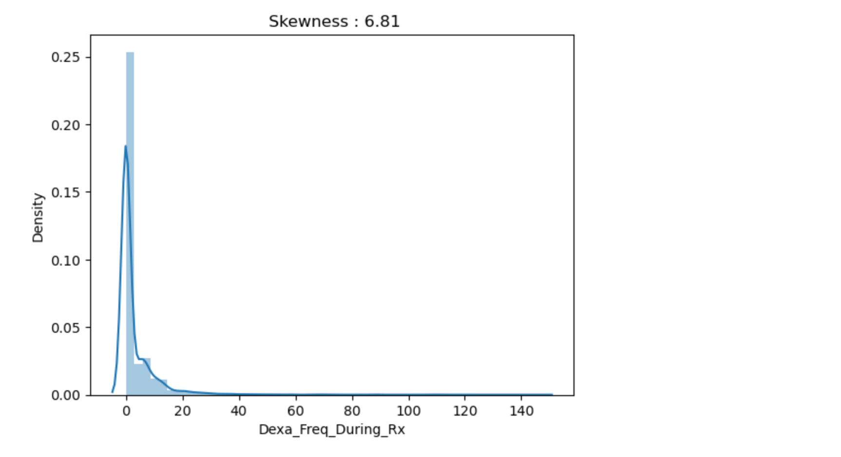
UNIVARIATE ANALYSIS : NUMERICAL COLUMN

Slide 10
UNIVARIATE ANALYSIS : CATEGORICAL COLUMNS

Slide 11
UNIVARIATE ANALYSIS : CATEGORICAL COLUMNS

Slide 12
UNIVARIATE ANALYSIS : CATEGORICAL COLUMNS

Slide 13
AGE DISTRIBUTION

Slide 14
BIVARIATE ANALYSIS : NUMERIC VS TARGET

Slide 15
BIVARIATE ANALYSIS : CATEGORY VS TARGET

Slide 16
BIVARIATE ANALYSIS : CATEGORY VS TARGET

Slide 17
EDA KEY TAKEAWAYS
Majority of patients belong to the >75 years age group
Persistency : 37.65% persistent, 62.35% non-persistent
Higher Dexa scan frequency correlates with higher persistency
Adherence, fragility fractures, risk factors are key variables
Insights directly shaped feature selection for modelling

Slide 18
STATISTICAL TEST SUMMARY
Shapiro – Wilk Test : Not normal
Levene’s Test : Unequal variance
Mann-Whitney U Test : It says patient’s who are persistent tend to have more Dexa scans during Rx
Conclusion:
Dexa scan frequency is statistically relevant
Non-parametric tests confirmed significant difference in Dexa frequency for persistent vs non-persistent patients

Slide 19
MACHINE LEARNING APPROACH
Explored multiple model families to align with business needs
Model Family : Linear, KNN, Tree, Ensemble, Boosting
Models Used : Logistic Regression, K-Nearest neighbours, Decision tree, Random forest, Gradient boost, XG boost, Voting classifier
Emphasis on interpretable outputs where possible – business requires explainability
Hyperparameter tuning and cross-validation are applied for optimal results

Slide 20
MODEL PERFORMANCE
Model Family | Model | Accuracy | Precision | Recall | F1 Score | Cohen Kappa
Linear | Logistic Regression | ~80% | ~78% | ~66% | ~72% | ~0.56
Linear Weighted | Logistic Regression (class weight) | ~80% | ~74% | ~74% | ~74% | ~0.58
KNN | K-Nearest Neighbours | ~78% | ~81% | ~57% | ~67% | ~0.51
Tree | Decision Tree | ~78% | ~72% | ~71% | ~71% | ~0.53
Ensemble | Random Forest | ~80% | ~81% | ~65% | ~72% | ~0.57
Boosting | Gradient Boost | ~81% | ~80% | ~69% | ~74% | ~0.59
Boosting | XG Boost | ~81% | ~79% | ~70% | ~74% | ~0.59
Ensemble | Voting Classifier | ~81% | ~78% | ~71% | ~74% | ~0.59
Boosting Final | XG Boost | ~82% | ~80% | ~70% | ~74% | ~0.60

Slide 21
FINAL MODEL
XG Boost chosen as final model due to its best accuracy as well F1 score and also because it is the fastest running algorithm/model among all models
Handles complex interactions well like complex datasets
Interpretable through feature importance
Meets business goal of actionable, reliable prediction

Slide 22
KEY BUSINESS INSIGHTS
Mild class imbalance in the data
Persistency drivers : Dexa frequency
Target high-risk patients with proactive follow-ups
Support care teams with predictive risk scores
Insights help in therapy plans

Slide 23
RECOMMENDATIONS
Integrate prediction in clinical workflows for timely actions
Use output for personalized patient education means to let them know about their treatment
Monitor key variables like Dexa scans and adherence regularly
Consider future model refinement with more data

Slide 24
NEXT STEPS
Validate model on new data periodically
Expand dataset with more demographic factors if possible
Build dashboard for operational teams use (if necessary)
Plan for gradual deployment in collaboration with stakeholders
Documents learning for future teams

Slide 25
THANK YOU

